Slide 1

Data 601 @ UMBC Data formats
Lecture 1
These notes are CC BY 4.0
If it were a real license, I'd use http://matt.might.net/articles/crapl/
Notes:
See also https://web.stanford.edu/class/stats101/intro/intro-lecture01.pdf for inspiration
Useful: https://arxiv.org/pdf/1503.05570.pdf
A Data Science Course for Undergraduates: Thinking With Data by Ben Baumer, The American Statistician Vol. 69 , Issue. 4
Timing in Fall 2018:
Slide 7 at minute 16
Slide 18 at minute 45
Slide 65 at minute 70
Finished in 2 hours, 20 minutes

Slide 2
For Fall 2020
Stop Teaching Code, Solicit Predictions Instead (upperlinecode.com)
-class material aspiration
https://news.ycombinator.com/item?id=21619884 - discussion

Slide 3
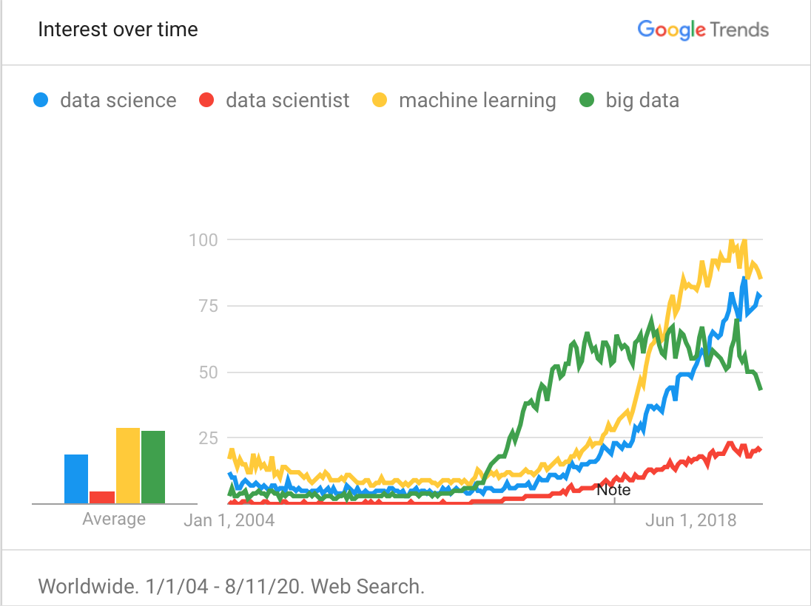
Welcome to Data 601
Once you’ve logged on,
Make sure you have how you like to be called on displayed in your Blackboard Collaborate session
Introduce yourself to your neighbors (Your randomly selected small group of 3)
Open Blackboard and join the Data 601 session
Notes:
https://trends.google.com/trends/
Blackboard gets used for the voting process in the CSV section of this lecture

Slide 4
Course Logistics
Course Logistics
What is Data Science?
Software tools
What are we not covering?
Data Formats
Soft skills
Homework

Slide 5
Outcomes for this evening
By the end of today's class, you should be able to answer the following:
What are three common plaintext data formats for semi-structured data?
What activities occur in the process of doing science?
What fields does data science draw on?
What is the motive for data science to occur?

Slide 6
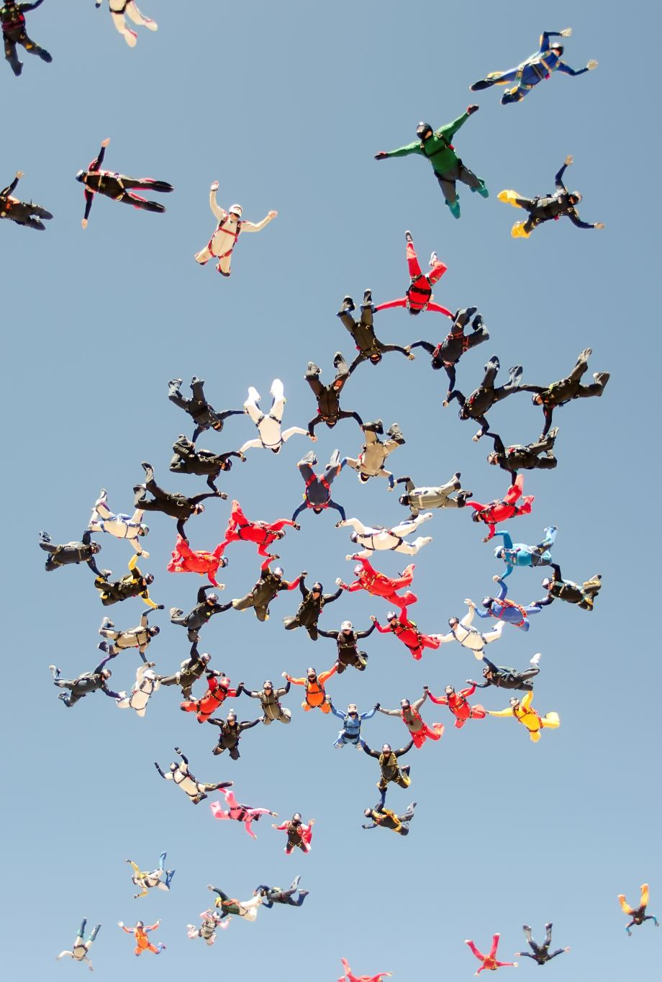
Components of an effective course
You will need to participate in the discussion on Blackboard
How do you promote a safe classroom environment?
How do you address the variety of backgrounds of participants?
How do you encourage participation? Enable rest?
What behaviors foster growth? How do you experience challenge?
Activity: Think, then Type
We will be sharing the output

Slide 7
Components of an effective course
How do you promote a safe classroom environment?
How do you address the variety of backgrounds of participants?
How do you encourage participation? Enable rest?
What behaviors foster growth? How do you experience challenge?
Activity: Think, then write; gather responses
Instructor records on Blackboard
Notes:
What students said, Fall 2019:
* interactive
* responsive
* ramp up of complexity
* hands-on exercises
* collaborate
* share
* account for and leverage diverse backgrounds

Slide 8

Logistics
You are welcome to join when I start the virtual session at 6:30 – 7:10
Schedule: 7:10 – 7:55, Break, 8:00 – 8:45, Break, 8:50 – 9:40
Also, it is acceptable to get up at any time and take a bathroom break
I value being punctual (start of class, breaks, end of class)
Please have your video on, and mute your audio during lecture
Raise your hand/send me a message in chat/unmute and speak up if you have a question
Don't apologize for asking a question or for not knowing something
I find it acceptable for you to occasionally not participate
Tell me if you cannot hear me or if you cannot understand me
Slides will be provided after lecture
I value your feedback:
Direct: verbal
Indirect: anonymous question/comment sheets on your desk

Slide 9
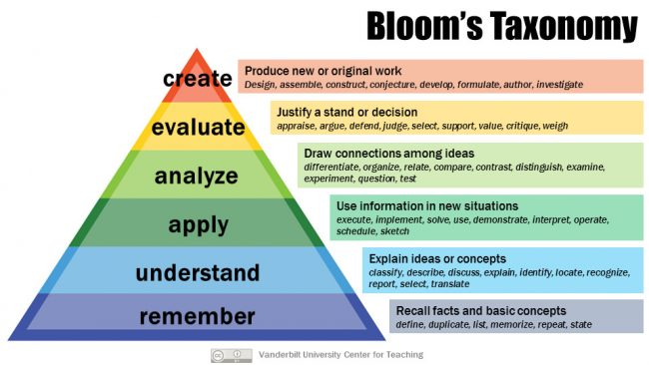
Grading Learning
What you may care about for evaluation
What I care about conveying
Attendance: 10%
Show up for class
Participate in class exercises and surveys
Homework: 30%
When homework is assigned, the due date will be provided
Project 1 and 2 and final: 20% each
Each project includes in-class activity

Slide 10
Academic Integrity (plagiarism, cheating)
Social collaboration will be a focus in class and team projects
Collaboration outside of project teams is not acceptable
Don't share code
Don't talk about homework design
Don't talk about solutions
Consequences (What's the disincentive?)
Decrease course grade by 4 to 6 points
Decrease course grade by 10 to 15 points

Slide 11

Log your assumptions and expectations
You will need: paper, pen or pencil
In-class exercise:
On a piece of paper or on your computer, record the date.
Write down your assumptions about this class
Write down your expectations for this class
Activity: think and write
We will not be sharing the output
Notes:
https://socialnicole.com/how-to-write-wikipedia-article/

Slide 12
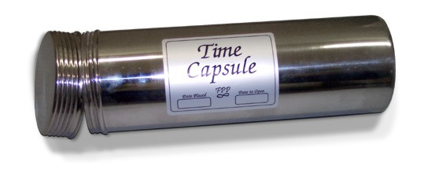
Store assumptions and expectations
We will revisit these notes later in the semester
Store your note where it can be accessed later in the course
Notes:
https://hsefoundation.org/donate/time-capsule/

Slide 13

What do you want to learn in this class?
Activity: record answers on Blackboard discussion
Notes:
Image source: https://www.compli.com/blog/survey/
What students said, Fall 2019:
* data privacy
* what is data science?
* how to use data science?
* practical applications
* Python versus alternatives
* how to start?
* how to solve problems?
* tools for data analysis
* how to manage data

Slide 14
Course schedule and outline (scope)
Overview of Data Science
Python in Jupyter
Getting data
Data cleanup
Automation, reports
Project 1 presentations
Math
Clustering
Scaling up
Regression
Property graphs
Elasticity, Cost/benefit
Ethics and Legality
Other Topics

Slide 15
What is Data Science?
Course Logistics
What is Data Science?
Software tools
What are we not covering?
Data Formats
Soft skills
Homework

Slide 16
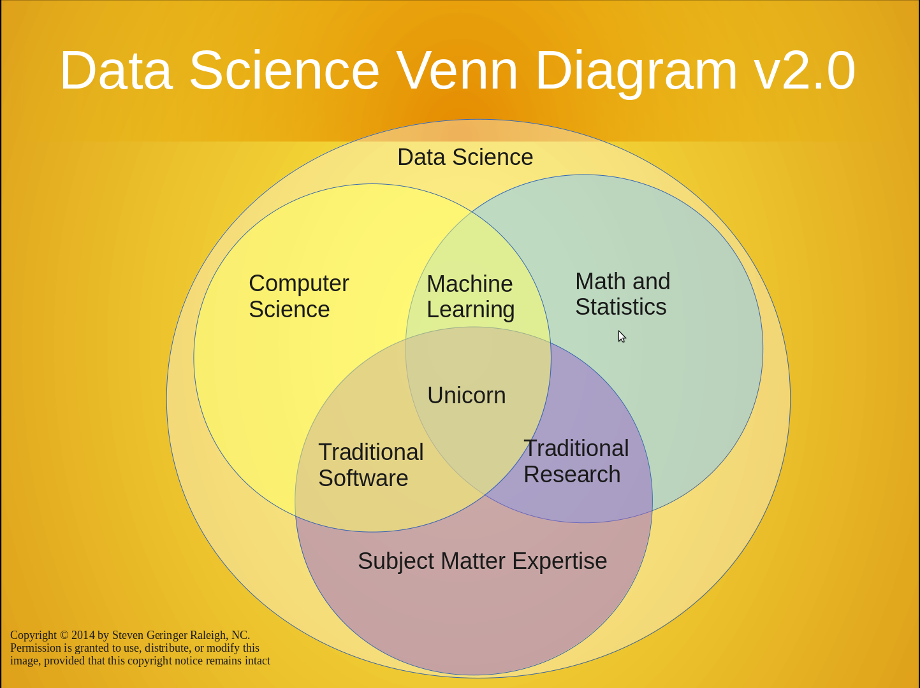
https://www.kdnuggets.com/2016/10/battle-data-science-venn-diagrams.html
There's a lot to cover
Suggested reading:

Slide 17
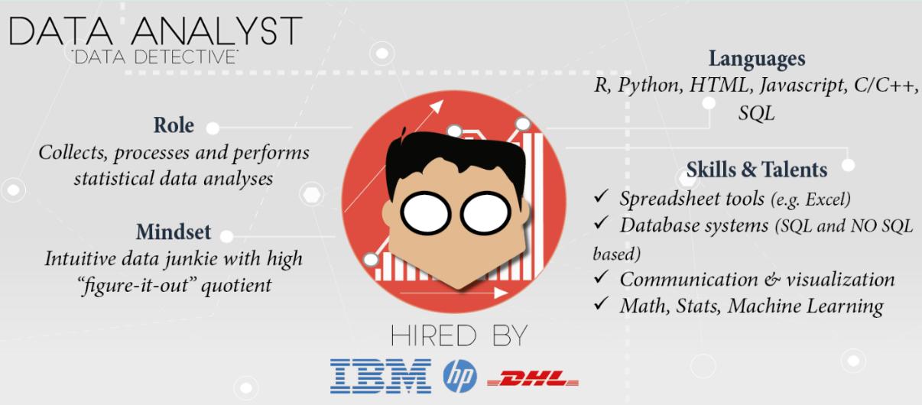
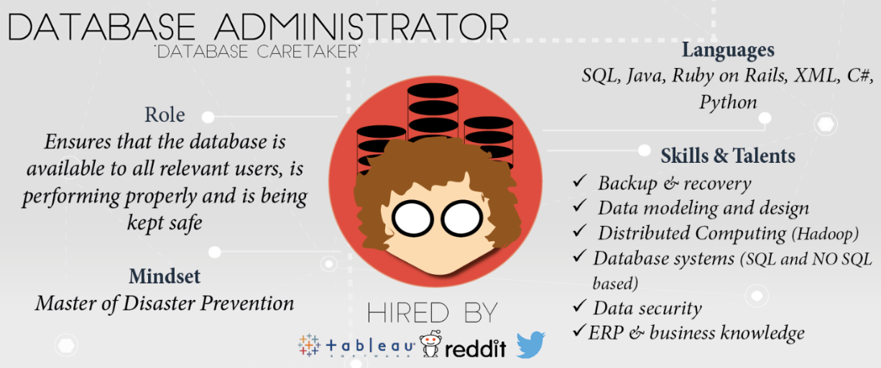
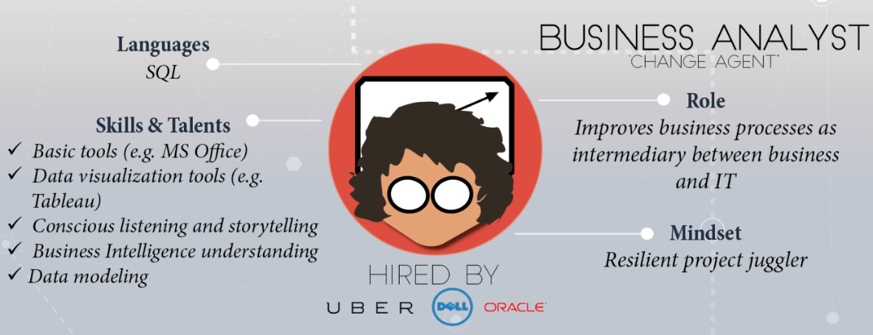
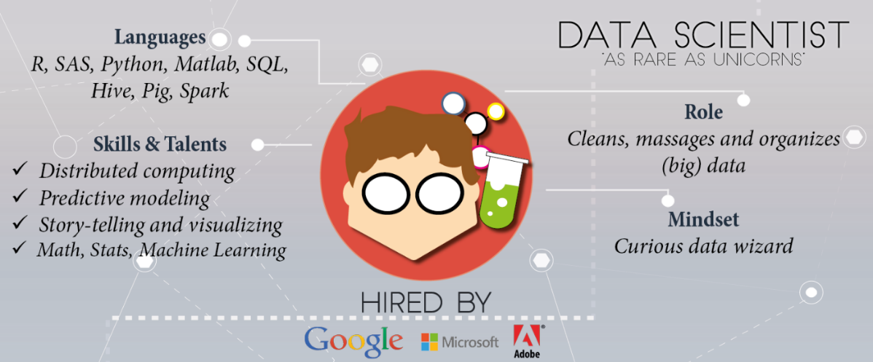
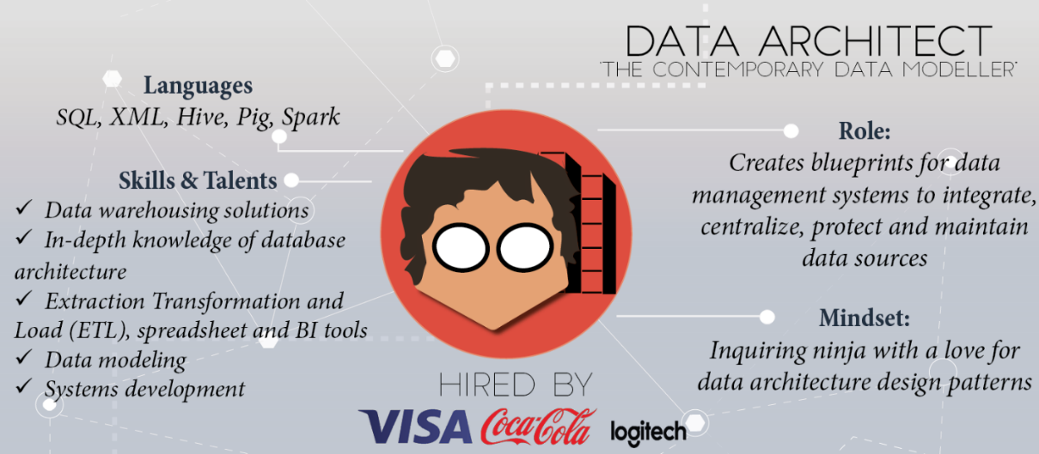
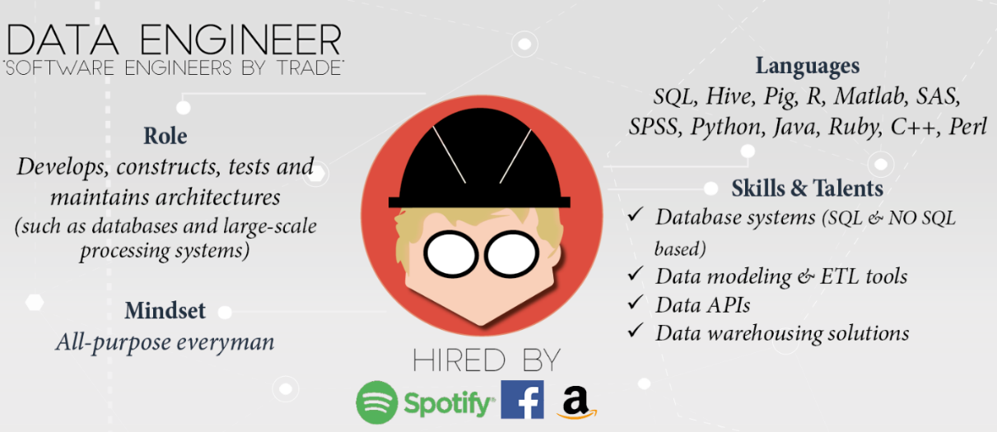
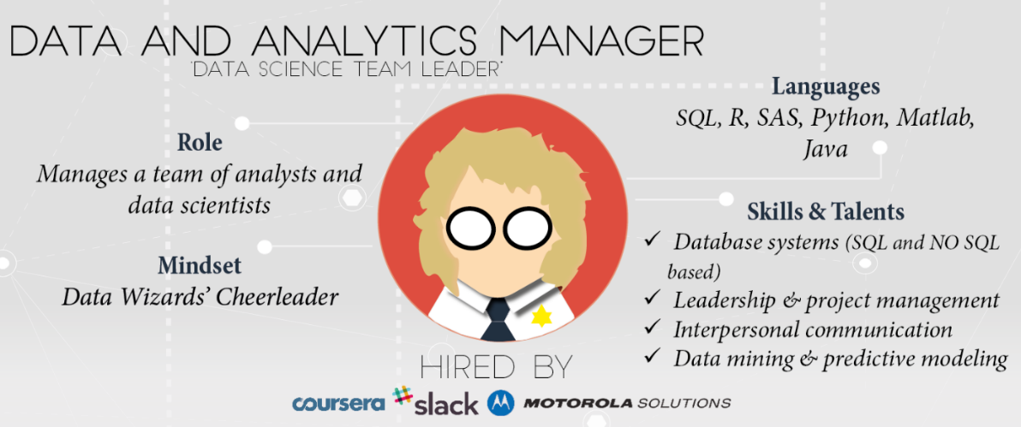
Skills and experience matter more than title and labels
https://www.datacamp.com/community/tutorials/data-science-industry-infographic
Historical progression: data grooming, data mining, data scientist

Slide 18

Data science is an active field with lots of jargon
There will always be something you haven't heard of before.
My advice:
Know enough to be conversant with peers
Be curious about new topics
Don't shame others or feel shame for not knowing something
Research concepts and labels before using them
Reference: http://www.datascienceglossary.org/

Slide 19
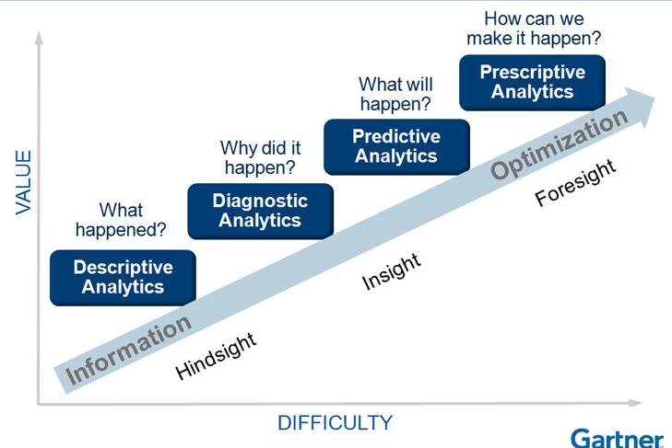
Why learn data science?
Explore: identify patterns​
Predict: make informed guesses​
Infer: quantify what you know
Motives:
Make money
Employment
Promotion
Help people
Gain new knowledge

Slide 20
Large scale use cases with lots of data
Google's search engine
Recommendations from Amazon and Netflix
Bank and Credit Card fraud detection
Logistics (DHL, UPS) of fleet management
Healthcare records from patients
Each depends on availability of compute and data
Notes:
https://www.thrillist.com/entertainment/nation/how-new-netflix-recommendation-algorithm-works#
https://medium.com/netflix-techblog/artwork-personalization-c589f074ad76
https://www.wired.co.uk/article/how-do-netflixs-algorithms-work-machine-learning-helps-to-predict-what-viewers-will-like

Slide 21
Assumption in this class
In class we will assume you are a lone data scientist on an island with an internet connection.
This is not the typical case -- you'll have coworkers, customers, bosses, competitors, collaborators, peers.
Example of how class ≠ real world
This class will not use competitive grading. (Imagine if it were.)
As an employee at a company, you may be competing for a bonus or promotion
--> consequence: personal and organizational politics factor into the work environment

Slide 22
Small scale use cases with not much data
As a business employee or bureaucrat or politician
How do I improve decision making process?
How do I evaluate the outcome of decisions?
How do I decrease the risk when faced with an opportunity?
How do I convince other stakeholders of the best course of action?
All while not taking too much time, not spending too much money, using the resources I already have access to, and in a way that is convincing?

Slide 23
Software Tools
Course Logistics
What is Data Science?
Software tools
What are we not covering?
Data Formats
Soft skills
Homework

Slide 24
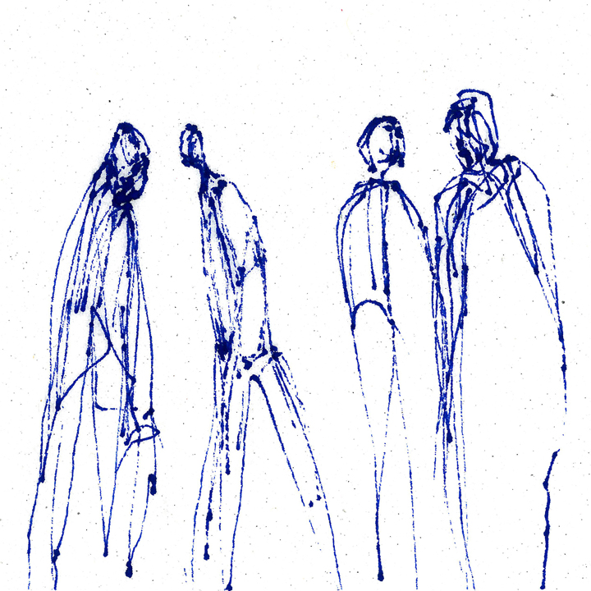
Most popular tool in data science
Stand up
Walk around Randomly assigned private chat partner
Introduce yourself to another person
Ask them what they think the most popular software tool in data science is and why
Report back to the class
Activity: interactive survey
https://www.trippinsights.com/2018/01/04/milling-about/
After survey, instructor aggregates responses on board
Notes:
https://www.trippinsights.com/2018/01/04/milling-about/
What students said, Fall 2019:
* Python
* R
* SAS
* Tableau
* numpy

Slide 25
Most popular tool in data science
Most popular tool in data science is Excel.
Excel is attractive because it's flexible and capable -- it can store data, the transform, and the visualization (no context switch).
However, as an analytic ages in Excel and is increasingly tailored, it becomes increasingly brittle.
Also, in the list of capabilities I didn't include documentation.

Slide 26
Most popular tool in Data 601: Python
Notes:
https://me.me/i/mustache-you-a-question-and-please-mullet-over-com-lilahdelilah-4900203

Slide 27


Most popular tool in Data 601: Python
Respond in Blackboard if you have heard of the programming language called Python

Slide 28
Most popular tool in Data 601: Python
Respond in Blackboard if you have used the programming language called Python

Slide 29
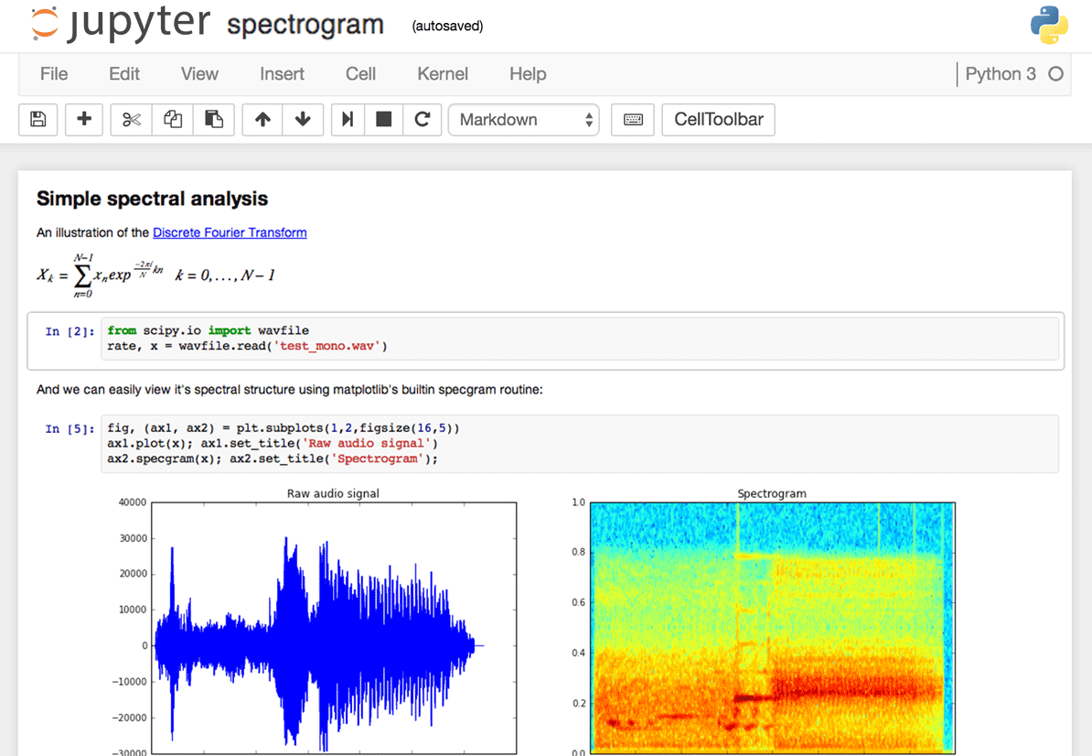

Interface to Python in Data 601: Jupyter
Raise your hand if you have used a Jupyter notebook
Notes:
Image source: https://www.dataquest.io/blog/jupyter-notebook-tips-tricks-shortcuts/

Slide 30

Why Jupyter + Python for Data 601?
Jupyter is useful for
Exploration of data (jargon: EDA = exploratory data analysis)
Documenting your activities (to enable reproducibility)
Figuring out which software is relevant, which algorithms to use, which software libraries are useful
Visualizing results
And both Jupyter and Python are free!
And both are widely used!
Notes:
Image source: https://imgflip.com/memetemplate/68354308/Do-all-the-things

Slide 31
Python and Jupyter do not cover every use case
For sufficiently large data sets, Jupyter and Python are not the right tool
For sufficiently complex analytics, Jupyter and Python are not the right tool
Speed and security are typically not your priority during exploration
Knowing when to invest in switching tools is a skill
Evaluate trade-offs of flexibility and security and speed for a given scale

Slide 32

Software infrastructure for data science
Usual explanation when replicating analysis:
Get this data
(Documentation) Apply this transformation to get result
No explanation of
software used
software versions
configurations
Implementation details
Digital archeology:
Suppose you are to diagnose why someone else's approach doesn't yield same results
Suppose they did their work 20 years ago

Slide 33
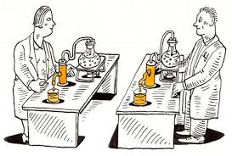
Infrastructure in data science to enable Reproducibility and Portability
In addition to data and analysis, implementation and environment matters
Use this Operating System
Install this software
Configure software this way
Add these packages
Get this data in this format
Run analysis against data
Create plots
Generate report

Slide 34
Best practices: Version control
Reproducibility applies to your own attempts (not just other people)
Regardless of how you develop analytics, you'll be creating or editing software and documents.
[lesson] Regardless of how you implement best practices, avoid inventing solutions for which someone else already provided a path.
Suggested resource: https://try.github.io/

Slide 35

Have you used software for version control?
Examples: git, svn, hg
Activity: Respond on Blackboad
Notes:
https://harveymilk.com/hmcra-family-survey-2/

Slide 36
What are we not covering?
Course Logistics
What is Data Science?
Software tools
What are we not covering?
Data Formats
Soft skills
Homework

Slide 37

Processes external to data science
Exploration may be enough and the effort terminates
Notes:
http://www.wiiplaygameslv.com/catalog/board_games-toyvault/but_wait_theres_more/406443

Slide 38

Processes external to data science
Exploration may be enough and the effort terminates
Additional refinement is often needed; data science is often merely the start of an investment
Notes:
http://www.wiiplaygameslv.com/catalog/board_games-toyvault/but_wait_theres_more/406443

Slide 39
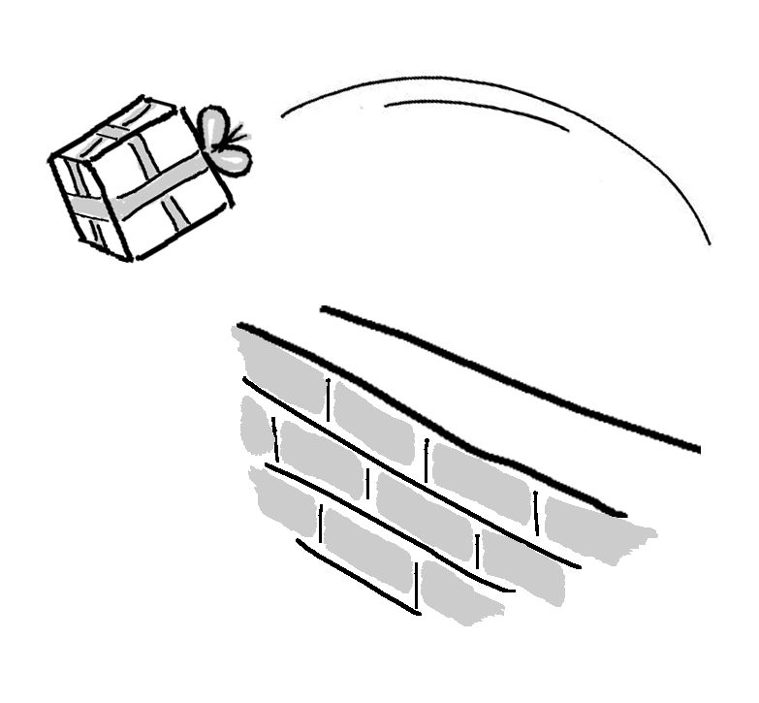
Not covered: product integration
There's a complex network of dependencies (i.e. software engineers, managers) of which data science is one component.
Downstream consumers of your output are likely to be software developers who use containers and support users.
This class is focused on the data science; not with integration.
See http://dev2ops.org/2010/02/what-is-devops/

Slide 40

Not covered: security
We focus on data science techniques; these do not emphasize secure design of software.
Notes:
https://betanews.com/2014/04/15/windows-8-1-without-update-will-no-longer-receive-security-updates/

Slide 41
Data Formats
Course Logistics
What is Data Science?
Software tools
What are we not covering?
Data Formats
Soft skills
Homework

Slide 42
We will discuss: data formats
Examples of data formats
CSV
Excel
JSON
XML
Unstructured text (i.e. txt)
Images (i.e. png, jpg, bmp, svg)
Sound (i.e. mp3, wav)
Images + sound: video
Plain text; how your data often is provided to you
Notes:
An outline of what I plan to cover in Data 601
https://www.loc.gov/preservation/resources/rfs/
https://www.loc.gov/preservation/resources/rfs/TOC.html
https://www.loc.gov/preservation/resources/rfs/stillimg.html#photodigital

Slide 43
Data formats for 601
CSV
JSON
XML
Excel
Dataframes
Relational Databases
Plain text
Platform independent
Not tied to specific software
--> Recommended data formats by the Library of Congress
See http://www.loc.gov/preservation/resources/rfs/data.html
Notes:
An outline of what I plan to cover in Data 601
https://www.loc.gov/preservation/resources/rfs/
https://www.loc.gov/preservation/resources/rfs/TOC.html

Slide 44
Data 601 focus is on numerical data and semi-structured text
There is more to cover within Data Science
unstructured text
image, sound, video
LDA - topic modeling
TF-IDF - document summarization
word2vec - word meaning
OCR - image to text
captioning - text for image
Object detection

Slide 45

Tables: what are they good for?
How would you represent course grades for Data 601 as a table?
(question is intentionally underspecified)
Activity: Raise your hand if you have a suggestion

Slide 46
Example of a table for course grades
Last Name | First Name | Homework 1 grade | Homework 2 grade | Exam grade
rgiasg | igmign | 79 | 84 | 92
qgimzf | gvdvig | 73 | 86 | 96
asgmi | ybgngfj | 58 | 42 | 71

Slide 47
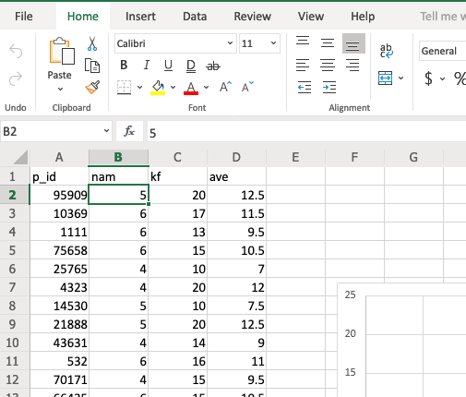
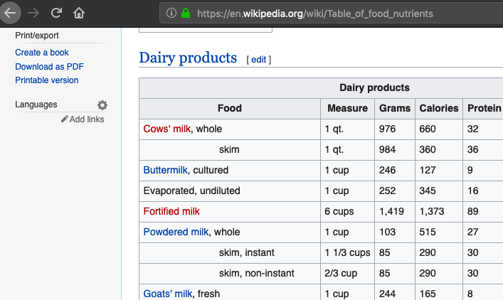
Where you have most likely seen tables:

Slide 48
Comments on Excel
Excel is widely used
Getting started in Excel is easy
Excel makes many tasks accessible
Excel is fragile
Excel does not scale up (or out)
Features in Excel are constrained
--> We will learn how to manipulate Excel from Python

Slide 49
Tables: what are they good for?
How would you represent a corpus of emails?
(question is intentionally underspecified)
Activity: Raise your hand if you have a suggestion

Slide 50
Example of a table for emails
Subject | From | To | Date | Has Attachment?
Doggy | Bob@gmail.com | Sam@yahoo.com | 2018-08-30 | N
Meeting time | Sam@yahoo.com | Alice@hotmail.com | 2018-09-01 | N
syllabus | Alex@gmail.com | Ari@gmail.com | 2018-09-06 | Y

Slide 51
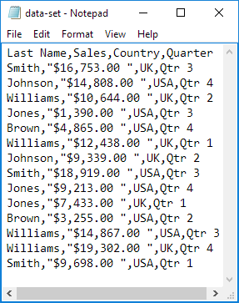
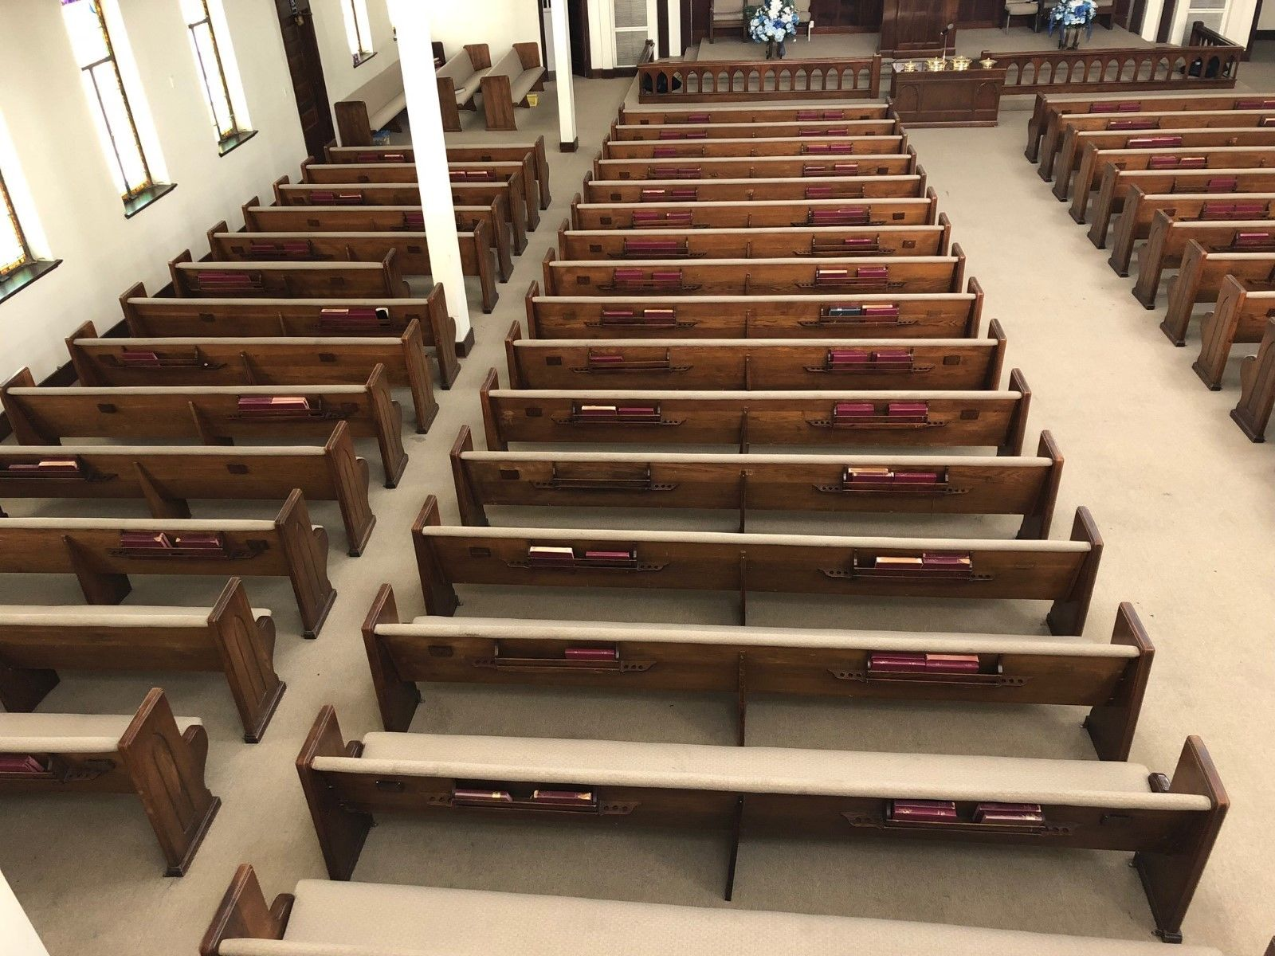

CSV
No set standard; see https://tools.ietf.org/html/rfc4180
https://en.wikipedia.org/wiki/Comma-separated_values
A table with rows and columns composed of text
Notes:
https://www.excel-easy.com/examples/import-export-text-files.html

Slide 52
CSV
No set standard; see https://tools.ietf.org/html/rfc4180
https://en.wikipedia.org/wiki/Comma-separated_values
A table with rows and columns composed of text
delimiters:
Line break (separates rows)
Comma (separates columns)
May or may not have a header:
First row is descriptions of columns
(a header consists of one or more rows, usually the first row)
Notes:
https://www.excel-easy.com/examples/import-export-text-files.html

Slide 53
CSV caveats
Text (not images, audio, video)
Each column of same type
Name or word or description (text)
Number
Category label (text)
Delimiters within a value
Enclosed within a pair of double quotes: " "
Quotes for quotes, ie 24"
Notes:
Image: https://www.excel-easy.com/examples/import-export-text-files.html
https://tools.ietf.org/html/rfc4180
https://stackoverflow.com/questions/17808511/properly-escape-a-double-quote-in-csv

Slide 54
CSV variations
Delimiters vary:
Tab – see https://en.wikipedia.org/wiki/Tab-separated_values
| (pipe)
Month|count|location
Jan|1332|here
June|5,593|there
Feb|953,24|everywhere, CA
Oct|592|my home town, MD
Can you see why using pipes would be desirable?
Notes:
https://en.wikipedia.org/wiki/Delimiter-separated_values

Slide 55
CSV alternative: fixed width
Consistent number of characters per column
ID l_name f_nametuition
0585822Potter, JrHarry 204
0485572Weasley Ron 958
5924245Granger Hermio422
4724926Diggory Cedric1042
4938243Weasley Fred 394
Can you see why fixed width would be desirable?
Notes:
https://www.excel-easy.com/examples/import-export-text-files.html

Slide 56
CSV alternative: fixed width
Consistent number of characters per column
ID l_name f_nametuition
0585822Potter, JrHarry 204
0485572Weasley Ron 958
5924245Granger Hermio422
4724926Diggory Cedric1042
4938243Weasley Fred 394
Caveat: each column needs to be at least as long as the longest entry
Notes:
https://www.excel-easy.com/examples/import-export-text-files.html

Slide 57

CSV quiz
When you see the question, don't shout out the answer.
Use Blackboard for voting on answers;
the colored cards are a backup.

Slide 58
Name, year, class, grade
Ming, 2013, Data 601, B
Imgb, 2015, Data 601, B
Rimgw, 2012, Data 601, A
Wemf, 2014, Data 602, C

Slide 59
Name, year, class, grade
Ming, 2013, Data 601, B
Imgb, 2015, Data 601, B
Rimgw, 2012, Data 601, A
Wemf, 2014, Data 602, C
Q: Does this CSV have a header?
(Don't shout out the answer)

Slide 60
Name, year, class, grade
Ming, 2013, Data 601, B
Imgb, 2015, Data 601, B
Rimgw, 2012, Data 601, A
Wemf, 2014, Data 602, C
Q: Does this CSV have a header?
Vote in Blackboard
Backup voting:
YES: vote with blue card
NO: vote with yellow card
NOT SURE: orange card

Slide 61
Name, year, class, grade
Ming, 2013, Data 601, B
Imgb, 2015, Data 601, B
Rimgw, 2012, Data 601, A
Wemf, 2014, Data 602, C
Q: Does this CSV have a header?
Answer -- YES: (blue card)
NO: vote with yellow card
NOT SURE: orange card

Slide 62
Name, year, class, grade
Ming, 2013, Data 601, B
Imgb, 2015, Data 601, B
Rimgw, 2012, Data 601, A
Wemf, 2014, Data 602, C
Q: Does this CSV have a header?
YES

Slide 63
Name, year, class, grade
Ming, 2013, Data 601, B
Imgb, 2015, Data 601, B
Rimgw, 2012, Data 601, A
Wemf, 2014, Data 602, C
Q: How many rows does this CSV have?
(Don't shout out the answer)

Slide 64
Name, year, class, grade
Ming, 2013, Data 601, B
Imgb, 2015, Data 601, B
Rimgw, 2012, Data 601, A
Wemf, 2014, Data 602, C
Row 1:
Row 2:
Row 3:
Row 4:
Row 5:
Col 1, Col 2, Col 3, Col 4
Q: How many rows does this CSV have?
5 rows
Why not 4?
Header is a row
Rows (5) versus columns (4)

Slide 65
Name, year, class, grade
Ming, 2013, Data 601, B
Imgb, 2015, Data 601, B
Rimgw, 2012, Data 601, A
Wemf, 2014, Data 602, C
Q: How many rows does this CSV have?
(Don't shout out the answer)

Slide 66
Name, year, class, grade
Ming, 2013, Data 601, B
Imgb, 2015, Data 601, B
Rimgw, 2012, Data 601, A
Wemf, 2014, Data 602, C
Q: How many rows does this CSV have?
Vote in Blackboard
Backup voting:
5 rows: vote with blue card
4 rows: vote with yellow card
NOT SURE: orange card

Slide 67
Row 1:
Row 2:
Row 3:
Row 4:
Row 5:
Name, year, class, grade
Ming, 2013, Data 601, B
Imgb, 2015, Data 601, B
Rimgw, 2012, Data 601, A
Wemf, 2014, Data 602, C
Col 1, Col 2, Col 3, Col 4
Q: How many rows does this CSV have?
Answer -- 5 rows: (blue card)
4 rows: vote with yellow card
NOT SURE: orange card
Why not 4?
Header is a row
Rows (5) versus columns (4)

Slide 68

Pandas: Dataframes and Series
Preview of next lecture
Series = "one-dimensional ndarrays with axis-labels" [citation]
Dataframe = "a dict-like container for Series objects" [citation]
Don't worry if these words are nonsense currently
We will cover the terms in more detail next week
Pandas only reports number of rows of data (does not include header in dataframe shape

Slide 69
Jupyter Notebook demo: CSV
data_formats/load_csv.ipynb

Slide 70
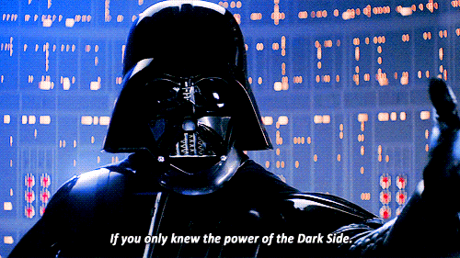
ID, last name, first name, tuition
058582, Potter, Jr, Harry, $204
0485572, Weasley, Ron, $958
592424, Granger, Hermione, $422
472492, Diggory, Cedric, $1,042
493824, Weasley, Fred, $394
Q: What is wrong with this CSV?
Activity: raise your hand if you have an answer
Notes:
https://support.clever.com/hc/en-us/articles/218518698-How-do-I-troubleshoot-CSV-formatting-errors-
image
https://bensbargains.com/thecheckout/awesomeness/25-hilarious-images-will-definitely-trigger-nerd-rage/

Slide 71

ID, last name, first name, tuition
058582, "Potter, Jr", Harry, $204
0485572, Weasley, Ron, $958
592424, Granger, Hermione, $422
472492, Diggory, Cedric, "$1,042"
493824, Weasley, Fred, $394
Q: What is wrong with this CSV?
A: Two mistakes with unquoted commas
Notes:
https://support.clever.com/hc/en-us/articles/218518698-How-do-I-troubleshoot-CSV-formatting-errors-
image
https://bensbargains.com/thecheckout/awesomeness/25-hilarious-images-will-definitely-trigger-nerd-rage/

Slide 72
Jupyter and CSV
docker run -it -e JUPYTER_ENABLE_LAB=yes \
-p 8888:8888 \
-v "$PWD":/home/jovyan \
benislocated/data-science-jupyter \
start.sh jupyter lab --NotebookApp.token=''
data_formats/load_csv.ipynb
docker run -it -e JUPYTER_ENABLE_LAB=yes -p 8888:8888 -v "$PWD":/home/jovyan benislocated/data-science-jupyter start.sh jupyter lab --NotebookApp.token=''

Slide 73
Reasons against CSV data format
data type of columns undefined
--> string versus float versus integer
This makes loading data from file to memory expensive
consistency of data types per row is not guaranteed
Row 1 could be "Bob, 52, 485-2949" while
Row 2 could be "859492, mark@yahoo.com, $95"
Format consistency is not enforced
Header could be comma separated, data is pipe separated, except fourth and fifth column are separated by semicolon
See Falsehoods Programmers Believe About CSVs

Slide 74

Additional common data formats: JSON and XML
Semi-structured_data for flexibility
JSON jargon: Key-value pairs
XML jargon: Tags, Elements, Attributes
Attributes contain data related to a specific element

Slide 75
Data format: JavaScript Object Notation (JSON)
{"menu": { "id": "file", "value": "File", "popup": { "menuitem": [ {"value": "New", "onclick": "CreateNewDoc()"}, {"value": "Open", "onclick": "OpenDoc()"}, {"value": "Close", "onclick": "CloseDoc()"} ] } }}
source: https://json.org/example.html
https://tools.ietf.org/html/rfc4627
Notes:
https://www.w3schools.com/js/js_json_intro.asp
https://beginnersbook.com/2015/04/json-tutorial/
https://www.tutorialspoint.com/json/

Slide 76
Data format: JavaScript Object Notation (JSON)
{"menu": { "id": "file", "value": "File", "popup": { "menuitem": [ {"value": "New", "onclick": "CreateNewDoc()"}, {"value": "Open", "onclick": "OpenDoc()"}, {"value": "Close", "onclick": "CloseDoc()"} ] } }}
Key-value pair separated by :
source: https://json.org/example.html
https://tools.ietf.org/html/rfc4627
Notes:
https://www.w3schools.com/js/js_json_intro.asp
https://beginnersbook.com/2015/04/json-tutorial/
https://www.tutorialspoint.com/json/

Slide 77
Data format: JavaScript Object Notation (JSON)
{"menu": { "id": "file", "value": "File", "popup": { "menuitem": [ {"value": "New", "onclick": "CreateNewDoc()"}, {"value": "Open", "onclick": "OpenDoc()"}, {"value": "Close", "onclick": "CloseDoc()"} ] } }}
Key-value pair where the value is a list of key-value pairs
source: https://json.org/example.html
https://tools.ietf.org/html/rfc4627
Notes:
https://www.w3schools.com/js/js_json_intro.asp
https://beginnersbook.com/2015/04/json-tutorial/
https://www.tutorialspoint.com/json/

Slide 78
How many key-value pairs does this JSON feature?
{"menu": { "id": "file", "value": "File", "popup": { "menuitem": [ {"value": "New", "onclick": "CreateNewDoc()"}, {"value": "Open", "onclick": "OpenDoc()"}, {"value": "Close", "onclick": "CloseDoc()"} ] } }}
source: https://json.org/example.html
https://tools.ietf.org/html/rfc4627
Notes:
https://www.w3schools.com/js/js_json_intro.asp
https://beginnersbook.com/2015/04/json-tutorial/
https://www.tutorialspoint.com/json/

Slide 79
How many key-value pairs does this JSON feature?
{"menu": { "id": "file", "value": "File", "popup": { "menuitem": [ {"value": "New", "onclick": "CreateNewDoc()"}, {"value": "Open", "onclick": "OpenDoc()"}, {"value": "Close", "onclick": "CloseDoc()"} ] } }}
source: https://json.org/example.html
https://tools.ietf.org/html/rfc4627
There are 11 key value pairs
Notes:
https://www.w3schools.com/js/js_json_intro.asp
https://beginnersbook.com/2015/04/json-tutorial/
https://www.tutorialspoint.com/json/

Slide 80
JSON in action
data_formats/load_json.ipynb

Slide 81
Reading JSON in Jupyter
docker run -it -e JUPYTER_ENABLE_LAB=yes \
-p 8888:8888 \
--net=dockernet \
-v "$PWD":/home/jovyan \
benislocated/data-science-jupyter \
start.sh jupyter lab --NotebookApp.token=''
data_formats/load_json.ipynb
docker run -it -e JUPYTER_ENABLE_LAB=yes -p 8888:8888 -v "$PWD":/home/jovyan benislocated/data-science-jupyter start.sh jupyter lab --NotebookApp.token=''

Slide 82
Data format: Extensible Markup Language (XML)
<menu id="file" value="File"> <popup> <menuitem value="New" onclick="CreateNewDoc()" /> <menuitem value="Open" onclick="OpenDoc()" /> <menuitem value="Close" onclick="CloseDoc()" /> </popup> </menu>
Element
Attribute
attributes cannot contain multiple values (elements can)
attributes cannot contain tree structures (elements can)
Source: https://www.w3schools.com/xml/xml_attributes.asp
source: https://json.org/example.html
https://tools.ietf.org/html/rfc2376
Notes:
https://www.w3schools.com/xml/
https://www.w3schools.com/xml/xml_whatis.asp
https://www.tutorialspoint.com/xml/

Slide 83
Multiple representations in XML
<person>
<firstName>John</firstName>
<lastName>Smith</lastName>
<age>25</age>
<address>
<street>21 2nd Street</street>
<city>New York</city>
<state>NY</state>
<zip>10021</zip>
</address>
</person>
There are no rules about when to use attributes or when to use elements in XML.
Source: https://en.wikipedia.org/wiki/JSON#XML_samples
<person firstName="John" lastName="Smith" age="25">
<address street="21 2nd Street" city="New York" state="NY" zip="10021" />
</person>

Slide 84
Parsing XML
data_formats/load_xml.ipynb

Slide 85
Reading XML in Jupyter
docker run -it -e JUPYTER_ENABLE_LAB=yes \
-p 8888:8888 \
--net=dockernet \
-v "$PWD":/home/jovyan \
benislocated/data-science-jupyter \
start.sh jupyter lab --NotebookApp.token=''
data_formats/load_xml.ipynb
docker run -it -e JUPYTER_ENABLE_LAB=yes -p 8888:8888 -v "$PWD":/home/jovyan benislocated/data-science-jupyter start.sh jupyter lab --NotebookApp.token=''

Slide 86
There are more data formats used in different situations
HDF5 – for extremely large and complex data collections.
pickle - data serialization for Python
See https://www.benfrederickson.com/dont-pickle-your-data/

Slide 87
Soft skills
Course Logistics
What is Data Science?
Software tools
What are we not covering?
Data Formats
Soft skills
Homework

Slide 88
Data Science is more than Math and Software
Human interaction in data science
Discovering stakeholders
Negotiating with data owners
Customer engagement
https://hbr.org/2017/01/the-best-data-scientists-get-out-and-talk-to-people

Slide 89
Iterating with customers
As a data scientist, you'll often be working for someone other than yourself.
Expect under-specified requirements from customers. Iterate.
Provide incomplete solutions rather than waiting until the product is perfect.
https://en.wikipedia.org/wiki/Minimum_viable_product

Slide 90

When to persist, When to change course, When to seek help
Try attacking the challenge for 30 minutes
Then seek help or do something else for a while
https://en.wikipedia.org/wiki/Pomodoro_Technique
Notes:
http://finalfantasy.wikia.com/wiki/Level_grinding
https://en.wikipedia.org/wiki/Grinding_(gaming)
https://www.vectorstock.com/royalty-free-vector/timer-sign-icon-30-minutes-stopwatch-symbol-vector-3756908

Slide 91
Pro-tip when seeking help
How to ask well-formed questions:
https://stackoverflow.com/help/how-to-ask
[Intentional sidetrack to StackOverflow.]
Ask technical questions:
Poor: "I don't understand Python dictionaries" (--> online tutorials)
Better: "When is it appropriate to use a key-value pair?"
Poor: If I submitted this assignment as is, what score would I get?
Better: I am planning to submit the attached assignment, but currently there's an error in the third cell. I've searched online but don't find any references to the error message. Can you provide guidance?

Slide 92

Emotions in Data Science
As a data scientist, most of your time will be spent in a desert of uncertainty, frustration, and doubt.
There will be rare short-lived interspersed spikes of excitement and happiness due to events like getting a new dataset, creating a new analytic, getting a new result, or being thanked by a stakeholder.
This experience is normal and does not go away.
See also the psychology of slot machines
Notes:
https://www.vhtcx.com/wp-content/uploads/2015/02/canstockphoto3986275.jpg
https://www.vhtcx.com/blog/5-causes-customer-frustration-fix/

Slide 93
Homework
Course Logistics
What is Data Science?
Software tools
What are we not covering?
Data Formats
Soft skills
Homework

Slide 94
Task: Jupyter with Python 3 kernel
Local installation on your computer:
https://jupyter.org/install
Requires Python installation, as well as Anaconda
Backup: Web-based (free, no guarantee of availability, features vary)
https://colab.research.google.com/
https://mybinder.org/
Depends on reference to github repository
I use Docker, but I provide support for students using Anaconda

Slide 95
Homework: Reading and Essay
You will be assigned one of the following texts to read:
First 10 pages of "50 years of data science"
or
A Very Short History Of Data Science
Write a half page summary of the text; see rubric for objectives and criteria
Submit essay via Blackboard
Bring your summary to class next week
Action: Read, write, tell
Notes:
Timeline: http://www.dataversity.net/brief-history-data-science/

Slide 96
Homework: Calculate course grade
Time investment challenage: 2 hours
Description: Suppose the course grade is based on 30 assignments (each scored 0 to 100), three projects (each scored 0 to 100), and attendance in 15 classes (each scored as present or absent). The assignments account for 30% of the course grade, the projects are 20% each (60% total), and attendance is 10% of the course grade. Suppose 10 of the 30 assignments are included in the final course score. Use random selection. Letter grades are defined in the syllabus
Choose one of the following options:
Describe in writing how you would calculate the course grade for one student. Submit your written description as a text file
Write a program in Python 3 that calculates the final grade for a student. Submit a Jupyter notebook via Blackboard.

Slide 97
I don’t know how to complete this assignment so I'm panicking. What should I do?
Consult the instructor via email
Schedule an in-person discussion with the instructor
The assignment is meant to give me a rough sense of where your current programming ability is. Students come to this course with a variety of backgrounds. Do not consult other students for answers — that would only give me a false impression of where your starting point is, and make it harder to know how to best help you grow in the next several weeks. You may use whatever internet resources you find yourself. Please include citations for the URL or textbook title.

Slide 98
Online resources (in addition to books)
Meetups
https://www.meetup.com/topics/data-science/
https://www.meetup.com/BigDataBaltimore/
https://www.meetup.com/Statistical-Seminars-DC/events/254200651/
News and blogs
https://www.kdnuggets.com/
https://news.ycombinator.com/
https://hackernoon.com/
https://www.reddit.com/r/datascience/
https://dataelixir.com/newsletters/
Online courses
Coursera
https://www.coursera.org/learn/machine-learning/home/welcome

